Slide 1


Short-Term Air Pollution Patterns:
A GIS Study of PM₂.₅, O₃ and NO₂ Emissions in the
Greater Toronto and Hamilton Area, 2024​
Arunima Dey, Dema Ismail, Elina Jaggi & Eaint Paing

Slide 2
Problem Statement & Scope
Fixed air quality monitoring stations do not fully capture spatial variation in pollution across the Greater Toronto and Hamilton Area, particularly in areas outside station buffer zones.
Scope:
  Focus on pollution variation beyond monitoring station coverage
  Hourly PM₂.₅, NO₂, and O₃ data (Air Quality Ontario, 2024)
  One-week GPS trajectories collected by the team
  Spatial interpolation used to estimate pollution surfaces
  Trajectory data used to confirm interpolated patterns
The stations mapped

Slide 3
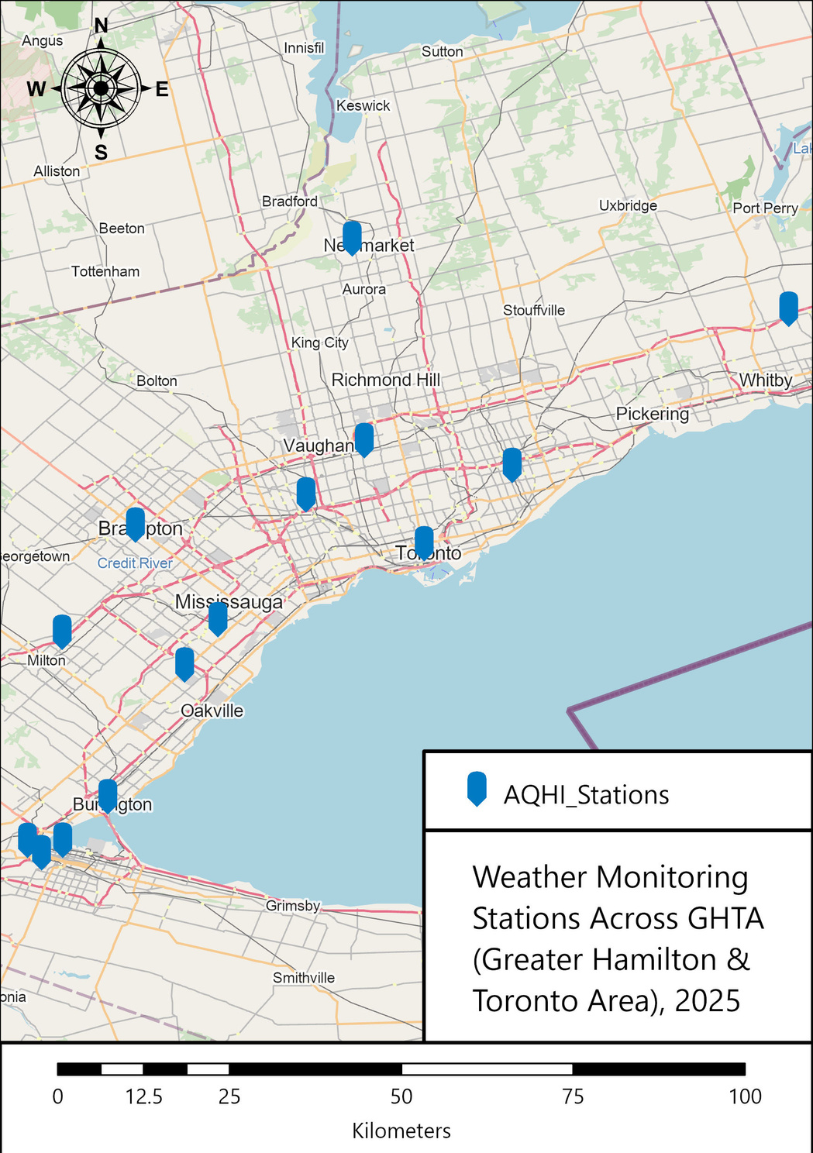

Slide 4
Data Used
Mobile Trajectory Data (Survey123 / GeoTracker)
GPS-based mobility data used to understand movement patterns and link human mobility with pollution exposure.
Air Quality Ontario (2024 hourly emissions)
Hourly pollutant measurements (PM₂.₅, NO₂, O₃) collected from monitoring stations across the GTA.
2021 Census Tract Data from Region of Peel, Durham, Open data Portal

Slide 5
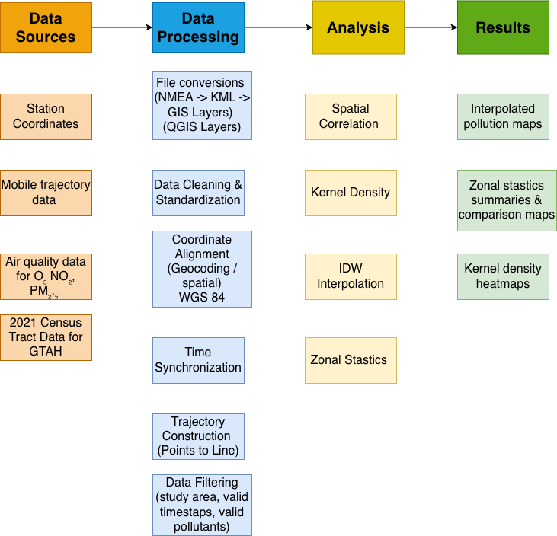

Slide 6

Methodology
2. Data Processing
File Conversion
GPS data were converted from NMEA to KML, then loaded into GIS as XY event layers.
Data Cleaning
Removed missing and duplicate records.
Standardized timestamp formats and pollutant fields.
Filtered trajectory points outside the study area.
Coordinate System Alignment
All datasets were projected to WGS 84 to ensure consistency for spatial analyses.
Trajectory Construction
Converted GPS points into polylines using the Points to Line tool to represent continuous movement paths.

Slide 7
Methodology
3. Analysis
1. IDW Interpolation
Applied Inverse Distance Weighting (IDW) to station-based pollution data to create continuous pollutant surfaces (PM₂.₅, NO₂, O₃).These surfaces estimate pollution levels in areas without monitoring stations.
2. Zonal Statistics
Computed the mean pollutant concentration within spatial units such as census tracts, neighborhoods, and municipal boundaries. This step reveals how pollution varies across different socio-spatial regions and identifies which districts experience higher exposure.
3. Kernel Density Estimation (KDE)
Used KDE to generate pollution hotspot heatmaps.
KDE highlights where pollutants tend to cluster and where accumulation is highest across the GTA.

Slide 8
Methodology
4. Results
Interpolated Pollution Maps
Smooth, continuous surfaces for PM₂.₅, NO₂, and O₃ showing estimated pollution levels across the GTA.
Zonal Statistics Summary/Maps
Tables and maps showing average pollutant concentrations for each zone (census tract or region), useful for identifying high-exposure neighborhoods.
Kernel Density Heatmaps
Hotspot maps showing pollutant accumulation areas and spatial patterns of high pollution intensity.

Slide 9
Analysis & Preliminary Results
  The map on the next slide visualizes the full spatial extent of all group members’ trajectory data over one week.
  Each line represents the actual GPS tracks recorded from daily routines, such as commuting, going to campus, work, errands, and weekend travel.
  The purpose of this map is to show where our personal exposure to air pollutants occurs as we move through the GTA region.

Slide 10
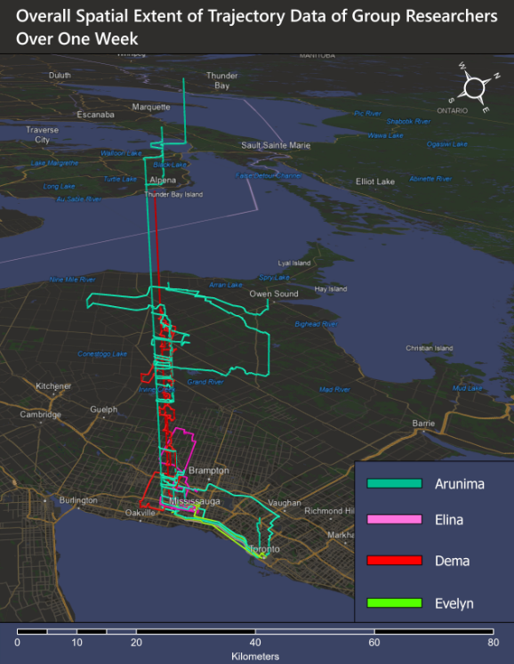

Slide 11
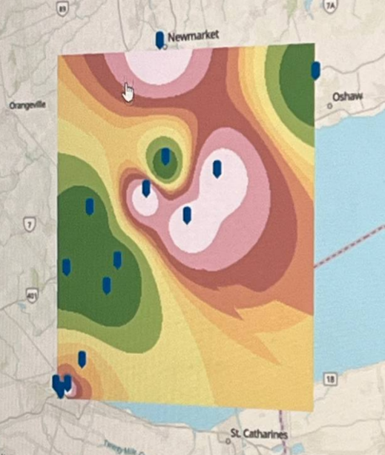

Slide 12
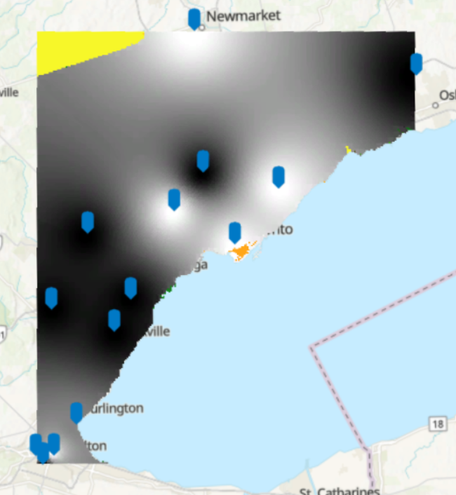

Slide 13
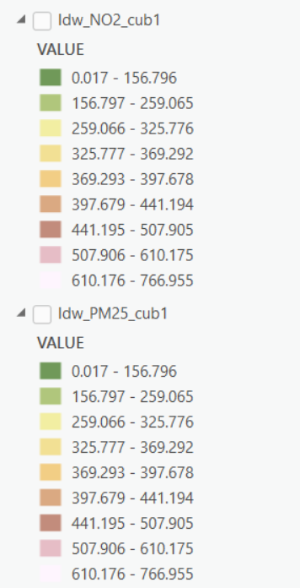
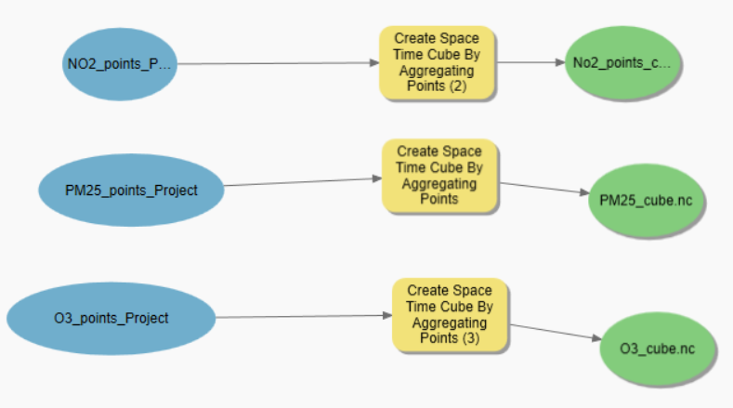

Slide 14
  High exposure zones likely overlap with dense neighborhoods
  Pollution varies by time of day and emission source
  Uneven station distribution creates data gaps
  Mobility data highlights personal exposure differences
Significant Findings

Slide 15
Limitations
01
Data Privacy (need to geomask)
02
Using a generalized GTA boundary limits neighborhood-level analysis and illustrates the Modifiable Areal Unit Problem (MAUP).

Slide 16
Conclusion
GIS helps identify pollution hotspots
Populatio overlap highlights exposure inequity
Mobility adds personal exposure insight
Analysis supports better health and planning decisions

Slide 17
Reference
Air Quality Ontario. (n.d.). Historical air quality data. Ontario Ministry of the Environment, Conservation and Parks. Retrieved November 25, 2025, from https://www.airqualityontario.com/history/index.php
Fotheringham, A. S., & Wong, D. W. S. (1991). The modifiable areal unit problem in multivariate statistical analysis. Environment and Planning A, 23(7), 1025–1044.

Slide 18
Team Contributions
EQUAL CONTRIBUTION AMONG ALL MEMBERS

Slide 19
Thank You

